Slide 1
Investment Oportumity
Cassava cultivation
and
Bioplastic production project
April 2025

Slide 2
Content
Company presentation
Why invest in the cassava cultivation and bioplastic production project in Mozambique?
Objective and advantages of the project
Process flowchart and plant layout
Domestic Market
Production capacity and costs
Sale projections

Slide 3

Company presentation, ECOPREGE
ECOPREGE, Engenheiros Consultores & Produtores de Recursos Geológicos, Limitada, a mining and sustainable energy company based at Av. Eduardo Mondlane, No 2022, Bairro Central C, Maputo City.
ECOPREGE is a young, dynamic company founded by a group of experienced engineers with a strong commitment to sustainability.
Our vision is to develop a leading company in the sustainable mining and energy sector in Mozambique, contributing to the country's economic development and protecting the environment.
For more information please contact:
+258 845533050 (Marcos Inácio)
+258 867013238 (Apolinário deixa)

Slide 4
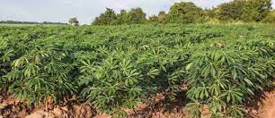
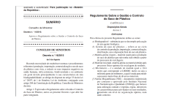
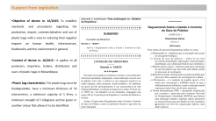
Why invest in the cassava cultivation and bioplastic production project in Mozambique?
High availability of arable land for cassava cultivation in Mozambique. Of the 36 million hectares of arable land, only 5 million hectares are cultivated;
Growing demand for biodegradable plastic products, which can be produced from cassava starch.
Exemption from payment of customs duties on the import of all machinery and equipment for the factory, including some fees to be applied for since the project will be submitted to APIEX
Fiscal, financial and regulatory incentives offered by the Mozambican government for the development of the agricultural sector:
  Reduce the VAT rate from 17 per cent to 16 per cent;
  VAT exemption on the import of inputs for agriculture and electrification;
  Lowering the IRPC rate from 32% to 10% for agriculture, aquaculture and urban transport;
  Reducing the clearance tax charged to foreign entities that provide services to national agricultural companies from 20 per cent to 10 per cent;
  eliminating the 20 per cent withholding tax on interest from external financing for agricultural projects;
  guaranteed access to land.

Slide 5
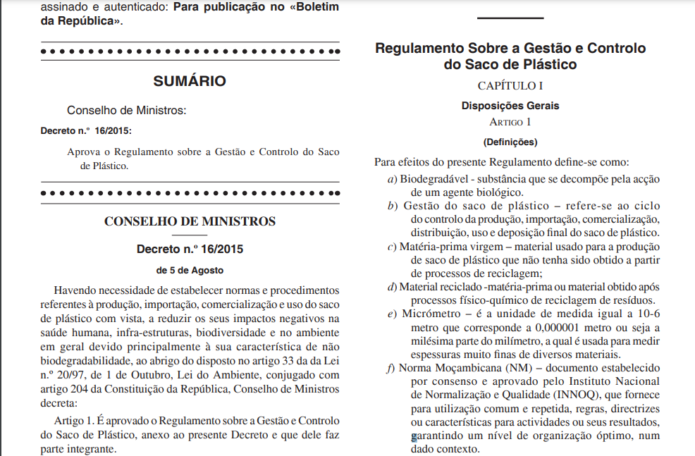
Support from legislation
Objective of decree nr. 16/2015: To establish standards and procedures regarding the production, import, commercialisation and use of plastic bags with a view to reducing their negative impacts on human health, infrastructure, biodiversity and the environment in general.
Context of decree nr. 16/2015 : It applies to all producers, importers, traders, distributors and users of plastic bags in Mozambique
Plastic bag characteristic: The plastic bag must be biodegradable, have a minimum thickness of 30 micrometres, a minimum capacity of 5 litres, a minimum strength of 5 kilograms and be green or another colour that allows it to be identified.

Slide 6

Objective and advantages of the project
Producing bioplastic from cassava starch.
Bioplastic is a sustainable alternative to hard-to-destroy inorganic plastics, as it is generally biodegradable and recyclable. Cassava is an abundant and accessible raw material in Mozambique, which makes the country an ideal location for the production of bioplastics.
Many advantages are expected from the project, such as:
Reduction of environmental pollution, especially in the oceans;
Improved quality of life;
Job creation;
Boost to the local economy;
Positioning the country as a benchmark in sustainability;
Making the country free of inorganic plastic consumption.

Slide 7

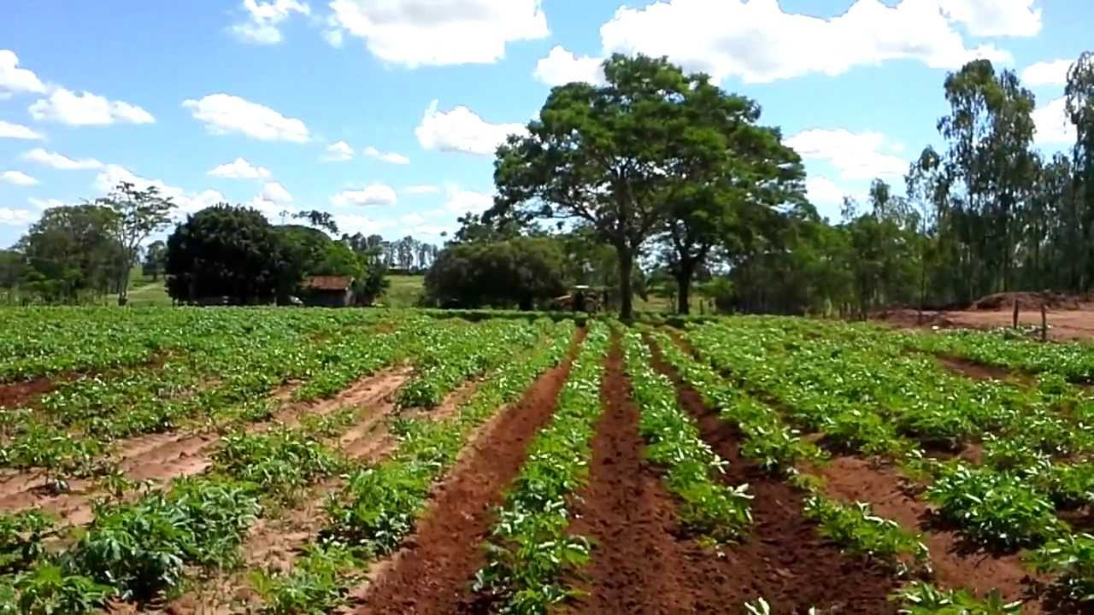
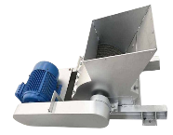
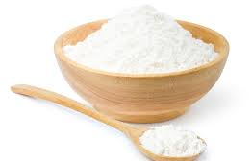
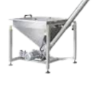

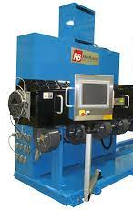

Process flowchart and plant layout (Base Scenario)
Fresh Cassava
Cassava Production
Ecoprege's long-term plan is to use this stage of the process to produce electricity
Cassava production area
Crushing
Fresh Cassava stock
Dry cassava Stock
Starch ProductionMachine
From cassava to Starch factory
From starch to PLA
PLA Granules Stock
Starch
PLA production machine
Eletrical instalations
Water facilities
PLA Granules

Slide 8
Process flowchart and plant layout (Alternative Scenario)
DATCO
Stock for bought Cassava Starch
Starch
From starch to PLA granules
PLA Granules Stock
PLA production machine
Eletrical instalations
Water facilities
PLA Granules

Slide 9
Domestic Market (still consuming inorganic plastic)
TOPACK MOCAMBIQUE-INDUSTRIA DE PLASTICOS S.A: A company that produces and sells plastic products such as buckets, drums, boxes, jars, crates, tables, chairs, pallets and preforms. The company operates out of Maputo and has clients in various sectors, such as food, beverages, construction, agriculture and industry.
Arkay Plastics (Moçambique), Limitada: It is a company that produces and distributes plastic products such as bottles, lids, cups, plates, cutlery, etc. The company is part of the Arkay group, which has operations in several African countries, such as Kenya, Malawi, Zambia, Tanzania, etc.
Plastex: The leading supplier of plastic storage tanks in Mozambique, with over 20 years' experience. The company offers solutions for storing water, fuel, chemicals and other liquids. The company operates from four strategically positioned factories: Nacala (in the north), Beira (in the centre), Tete (centre-west) and Maputo (in the south).
Savannah Fabrica De Tubos Plasticos: A plastic pipe factory founded in January 2017. Savannah's main activity is the manufacture and commercialisation of ISOGRIS, COPOLENE (HDPE), PPR, CORRUGATED, RINGED pipes and PPR accessories. The company serves the construction, sanitation, irrigation, mining and industrial sectors.
The domestic market is still dominated by inorganic plastic.
These companies are potential customers for ECOPREGE's bioplastics in the transition period to the exclusive use of bioplastics or biodegradable packaging.

Slide 10
Costs

Slide 11
Sales projections
 |  | Annual revenue
 | Year 0 | Year 1 | Year 2 | Year 3 | Year 4 | Year 5
 | 12/31/2024 | 12/31/2025 | 12/31/2026 | 12/31/2027 | 12/31/2028 | 12/31/2029
Plastic Granules
Units | 0 | 900,000 | 990,000 | 1,089,000 | 1,197,900 | 1,317,690
Unit price | 0 | 20 | 21 | 22 | 22 | 23
Total, Product A | 0 | 18,000,000 | 20,592,000 | 23,557,248 | 26,949,492 | 30,830,219
Product B
Number of clients | 0 | 0 | 0 | 0 | 0 | 0
Price by client | 0 | 0 | 0 | 0 | 0 | 0
Total, Product B | 0 | 0 | 0 | 0 | 0 | 0
Gross Revenue, VAT included | 0 | 18,000,000 | 20,592,000 | 23,557,248 | 26,949,492 | 30,830,219
Minus 16% VAT withheld at source | 0 | 2,482,759 | 2,840,276 | 3,249,276 | 3,717,171 | 4,252,444
Net revenue | 0 | 15,517,241 | 17,751,724 | 20,307,972 | 23,232,320 | 26,577,775
 |  | Monthly recipe
 |  | Year 0 | Year 1 | Year 2 | Year 3 | Year 4 | Year 5
Months |  | 12/31/2024 | 12/31/2025 | 12/31/2026 | 12/31/2027 | 12/31/2028 | 12/31/2029
Month 1 |  | 0 | 775,862 | 887,586 | 1,015,399 | 1,161,616 | 1,328,889
Month 2 |  | 0 | 775,862 | 887,586 | 1,015,399 | 1,161,616 | 1,328,889
Month 3 |  | 0 | 1,086,207 | 1,242,621 | 1,421,558 | 1,626,262 | 1,860,444
Total 1st Quarter |  | 0 | 2,637,931 | 3,017,793 | 3,452,355 | 3,949,494 | 4,518,222
Month 4 |  | 0 | 775,862 | 887,586 | 1,015,399 | 1,161,616 | 1,328,889
Month 5 |  | 0 | 1,086,207 | 1,242,621 | 1,421,558 | 1,626,262 | 1,860,444
Month 6 |  | 0 | 1,396,552 | 1,597,655 | 1,827,718 | 2,090,909 | 2,392,000
Total 2nd Quarte |  | 0 | 3,258,621 | 3,727,862 | 4,264,674 | 4,878,787 | 5,581,333
Month 7 |  | 0 | 1,551,724 | 1,775,172 | 2,030,797 | 2,323,232 | 2,657,777
Month 8 |  | 0 | 1,862,069 | 2,130,207 | 2,436,957 | 2,787,878 | 3,189,333
Month 9 |  | 0 | 2,327,586 | 2,662,759 | 3,046,196 | 3,484,848 | 3,986,666
Total 3rd Quarte |  | 0 | 5,741,379 | 6,568,138 | 7,513,950 | 8,595,959 | 9,833,777
Month 10 |  | 0 | 1,396,552 | 1,597,655 | 1,827,718 | 2,090,909 | 2,392,000
Month 11 |  | 0 | 1,396,552 | 1,597,655 | 1,827,718 | 2,090,909 | 2,392,000
Month 12 |  | 0 | 1,086,207 | 1,242,621 | 1,421,558 | 1,626,262 | 1,860,444
Total 4th Quarter |  | 0 | 3,879,310 | 4,437,931 | 5,076,993 | 5,808,080 | 6,644,444
Total do Year |  | 0 | 15,517,241 | 17,751,724 | 20,307,972 | 23,232,320 | 26,577,775

